Slide 1

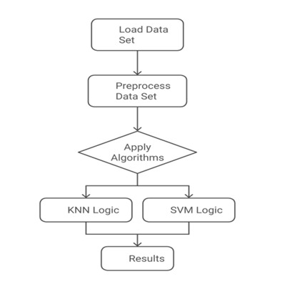
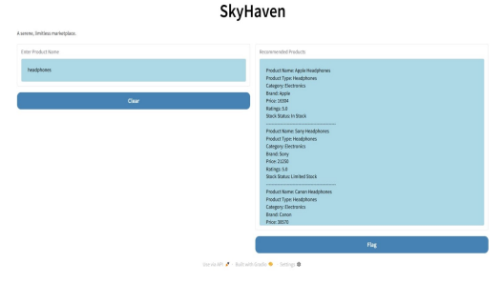
Product Recommendation system
Names of students:Nandesh, Priyanshu,Priyanka,Jamuna
Under guidance of : Dattaprasad A.Torse
Department of Electronics and Communication Engineering
Problem statement
Results
Users struggle to find relevant products online. This aims to create an efficient recommendation system using hybrid models to enhance personalization and accuracy.
Methodology
Our recommendation system boats high effectiveness in Precision of 86.7%, Recall of 83.2%, and F1 Score of 84.9%. This means the system is relevantly accurate for giving product recommendations and is thus a good balance between precision and recall.
Objectives
Design an efficient recommendation system that delivers personalized suggestions.
Utilize advanced algorithms like SVM and KNN for better proximity detection and classification.
Ensure real-time recommendations by incorporating product availability and user preferences.
Optimization details
Contributions
To obtain the proper recommendation we have made several improvement .The dataset was carefully modified ensuring the model could recommend the product .The architecture was fine tuned to balance accuracy and efficient .
Load Data Set – Collect user data (browsing history, purchases, ratings).
Preprocess Data – Clean, normalize, and transform data for model training.
Apply Algorithms – Choose between KNN (collaborative filtering) or SVM (classification-based recommendations).
KNN Logic – Finds similar users/items to suggest products.
SVM Logic – Classifies users into groups for personalized recommendations.
Results – Displays relevant product suggestions to users.
We have taken data set from kaggel ,we reduced No. of columns ,and feature to obtain required result for our project
Conclusions
Literature survey
The proposed recommendation system effectively combines machine learning algorithms and hybrid models to deliver accurate, personalized suggestions. By addressing key challenges such as data sparsity and cold-start issues, it enhances user experience and business profitability. With strong evaluation metrics, the system proves its potential for real-world applications, and future improvements in data handling and algorithmic precision promise even greater efficiency and scalability.
K-means and Apriori algorithms analyzed an Austrian retailer's sales data, linking demographics and buying behavior to specific product groups.
Improved market targeting by associating consumer categories with product groups.
Applicability is limited to one retailer; broader testing in other industries is needed.
Mini Project-2024-25

